Slide 1
ACUTE GINGIVAL INFECTIONS

Slide 2
NECROTISING ULCERATIVE GINGIVITIS
Microbial disease of gingiva in the context of impaired host response
Characterized by death & sloughing of gingival tissue

Slide 3
Etiology
Bacteria
Host response
- Psychosomatic factors
Predisposing Factors
Local
Systemic

Slide 4
Role of bacteria
Plaut & Vincent – fusiform bacilli & spirochetes

Slide 5
Role of host response
Bacteria insufficient to cause disease
Associated with physical & emotional stress & decreased resistance to infection
Not found in healthy individuals

Slide 6
Local predisposing factors
Preexisting gingivitis
Injury to gingiva (trauma caused by traumatic occlusion)
Periodontal pockets & pericoronal flaps
Smoking

Slide 7
Systemic predisposing factors
Immunodeficiency caused by
Nutritional deficiency
Debilitating disease- chronic disease (syphilis, cancer), GI disorders, Blood dyscrasias, AIDS

Slide 8
Epidemiology & Prevalence
Communicability

Slide 9
Clinical features
Exacerbations & remissions

Slide 10
History
sudden onset following an episode of:
debilitating disease,
resp tract infn,
inadequate rest, nutrition,
tobacco use
psychologic stress

Slide 11
Oral signs
Linear erythema
Punched out crater-like depressions at crest of interdental papilla may extend to MG rarely to AG
Pseudomembranous slough- gray in color, covers the surface of gingival craters
Denuded of pseudomembrane- exposed gingival margin is red, shiny and hemorrhagic.
lesions progressively destroy the gingiva & underlying periodontal tissues

Slide 12
Spontaneous gingival hemorrhage/ pronounced bleeding after slightest stimulation
Fetid odor
Increased salivation
Can occur in otherwise disease free mouths or superimposed on chronic gingivitis or periodontitis
Does not usually lead to pocket formation since necrotic changes involve junctional epithelium
Rare in edentulous mouths (isolated spherical lesions of soft palate)

Slide 13
Oral symptoms
Lesions are extremely sensitive to touch
Constant radiating gnawing pain intensified by eating spicy or hot foods and chewing
Metallic foul taste
Excessive amount of “pasty” saliva

Slide 14
Extraoral signs & symptoms
Mild & moderate disease- local lymphadenopathy & slight elevation in temperature
Severe disease – high fever, increased pulse rate, leukocytosis, loss of appetite & general lassitude
Systemic reactions more severe in children
Insomnia, constipation, GI disorder, headache & mental depression

Slide 15
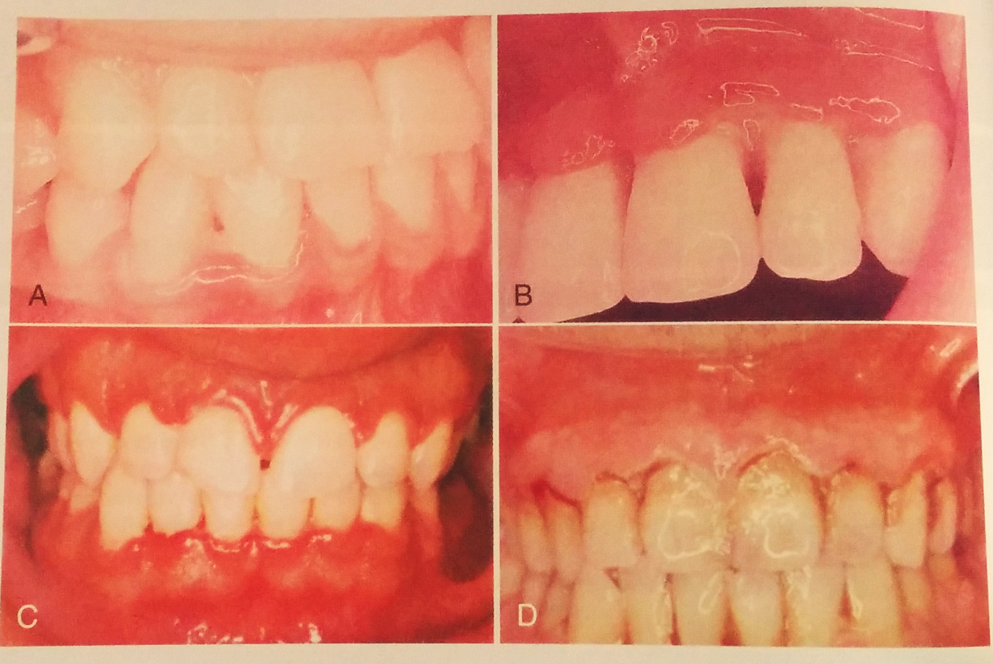
Clinical course
May vary
If untreated sequelae include
NUP
NUS
Noma

Slide 16
Relation of bacteria to the NUG lesion

Slide 17
Light microscopy
Exudate on surface of lesion - bacteria (cocci, fusiform bacilli & spirochetes)
Layer between necrotic & living tissue- fusiform bacilli & spirochetes, fibrin & leukocytes
spirochetes continue to invade underlying epithelium & C/T. higher concentrations intercellularly in epithelium adjacent to ulcerated lesion & in the C/T
Smears from the lesion –scattered bacteria (spirochetes & fusiform bacilli), desquamated epithelial cells& few PMNs

Slide 18
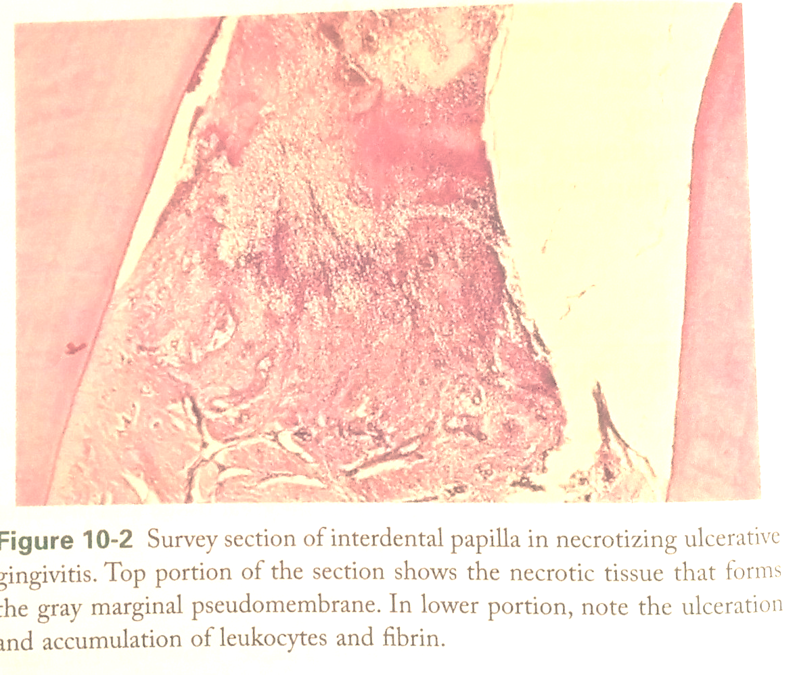
Histopathology
Microscopically NUG lesions are nonspecific acute necrotising inflammation of gingival margin involving both the stratified squamous epithelium & the underlying C/T

Slide 19
Epithelium
- Surface epithelium destroyed & replaced by meshwork of fibrin, necrotic epithelial cells, PMNS and various types of microorganisms
Epithelium at immediate border of psuedomembrane-
edematous
individual cells – hydropic degeneration
infiltration of PMNs in intercellular space

Slide 20
Underlying C/T
- Hyperemic, numerous engorged capillaries, dense infiltration of PMNs (clinically LGE)
Numerous plasma cells in the periphery area of chronic gingivitis on which acute lesion superimposed.
Epithelium & C/T alterations decrease as distance from necrotic gingival margin increases

Slide 21
Diagnosis
Clinical findings- gingival pain, ulceration & bleeding
Bacterial smear for differentiation from other specific infections of oral cavity
Microscopic examination of biopsy differentiate from specific infn like TB, Neoplastic disease

Slide 22
Differential diagnosis
Herpetic gingivostomatitis
Chronic Periodontitis
Desqamative Gingivitis
Streptococcal gingivostomatitis
Diptheria
Syphilis
Tb
Candidiasis
Agranulocytosis

Slide 23
NUG | Primary herpeticgivostomatitis
Etiology- interaction between host & bacteria(fusospirochetes) | Specific Viral etiology
Necrotising condition | Diffuse erythema & vesicular eruption
Punched out gingival margin, pseudomembrane that peels off & leaves raw areas | Vesicles rupture & leave slightly depressed oval / spherical ulcer
Marginal gingiva affected | Diffuse involvement of gingiva may include buccal mucosa & lips
Uncommon in children | More frequently in children
No definite duration | 7-10 days
No demonstrated immunity | Acute episode results in some degree of immunity
Contagion not demonstrated | Contagion

Slide 24
 | NUG | DG | CP
Bacterial smear | Fusospirochetal complex | Epithelial cells, few bacterial forms | Variable
involvement | Marginal gingiva | Diffuse | MG
History | Acute | Chronic | Chronic
Pain | Painful | +/- | Painless if uncomplicated
Epithelium | pseudomembrane | Patchy desquamation | Purulent material from pockets
Necrotic lesions | Papillary & marginal | Papillae don’t undergo necrosis | Papillae don’t undergo necrosis
prevalence | Both genders occasionally children | Mostly women | Both genders occasionally children
Odor | fetid | none | Not strikingly fetid

Slide 25
 | NUG | Diptheria | Secondary stage of syphilis
Etiology | Host & fusospirochetes | Corynebacterium diptheriae | Treponema pallidum
Involvement | Marginal gingiva | Throat, fauces & tonsils | Any part of mouth
Membrane removal | Easy | difficult | Not detachable
Pain | + | Less painful | Minimal pain
Serologic findings | normal | normal | abnormal
Immunity | Not conferred | Conferred | Not conferred
Contagion | ??? | Contagion | Only direct contact
Antibiotic therapy | Relieves symptoms | Minimal effect | Excellent results

Slide 26
Clinical course classification by Horning and Cohen
Stage 1: necrosis of tip of papilla
Stage 2: entire papilla
Stage 3: extending to gingival margin
Stage 4: attached gingiva
Stage 5: buccal or labial mucosa
Stage 6: exposing alveolar bone
Stage 7: perforating skin of cheek

Slide 27
Treatment
Aims at
Alleviation of the acute inflammation by reducing the microbial load and removal of necrotic tissue
Treatment of the chronic disease underlying acute involvement or elsewhere in oral cavity
Alleviation of generalised symptoms e.g fever , malaise
Correction of systemic conditions or factors that contribute to the initiation or progression of gingival changes

Slide 28
First visit
Complete history and examination- probing contraindicated
Goal of initial therapy- reduce microbial load and remove necrotic tissue to the degree that repair and regeneration of normal tissue barriers are reestablished

Slide 29
Treatment confined to acutely involved areas
Isolated with cotton rolls –dried- topical anesthetic applied – 2-3 minutes- area gently swabbed with moistened cotton pellet to remove pseudomembrane and nonattached surface debris
Bleeding maybe profuse
Each pellet in small area then discarded
Cleansed with warm water
Supragingival scaling – ultrasonic- painless, cavitation and water jet aid in lavage

Slide 30
Subgingival scaling, periodontal surgery, extractions – postponed to symptom free state(4 weeks)
Moderate or severe NUG (localised lymphadenopathy or other systemic symptoms)- antibiotics amoxicillin 500mg qid
Sensitive- erythromycin 500mg qid or
Metronidazole 500mg bd

Slide 31
Instructions to patient
Avoid tobacco, alcohol,
Rinse with a glass of equal mixture of 3% H2O2 and warm water every 2 hrs and/or twice daily with 0.12% CHX
Get adequate rest
Confine toothbrushing to removal of surface debris with a bland dentrifice and an ultrasoft brush
Analgesic for pain relief
Systemic complications- antibiotics, symptomatic therapy and bed rest
Recall essential

Slide 32
Second visit
1-2 days after first visit
Evaluate for amelioration of s/s
Supragingival scaling
Instructions to patient like before

Slide 33
Third visit
Approx 5 days after first visit
Patient symptom free
OHI, diet and habit-cessation counseling
H2O2 rinse stopped CHX rinse continued for 2-3weeks
SRP
Appts for treatment of chronic gingivitis, chronic periodontitis and removal of local irritants
Reevaluation after 1 month for compliance to OHI, nutrition & psychosocial factors

Slide 34
Gingival changes with healing
Removal of pseudomembrane exposes underlying red , hemorrhagic, crater-like depressions in the gingiva
Next stage- bulk and redness of crater margins reduced – reepithelialization
Reestablishment of normal barrier function of of epithelium- keratinization & reduced inflammation
Final stage – all features of healthy gingiva restored

Slide 35
Additional treatment considerations
Contouring of gingiva
Systemic antibiotics and topical antimicrobials
Supportive systemic treatment
Nutritional supplements

Slide 36
Persistent or recurrent case
Reassessment of D/D
Underlying systemic disease causing immunosuppression
Inadequate local therapy
Inadequate compliance

Slide 37
Primary herpetic gingivostomatitis
Infection of oral cavity
HSV-I
Infants & children <6yrs also in adolescents & adults
Male= female
History – as a result of acute infection by HSV and has an acute onset

Slide 38
As part of primary infn ascends through sensory & autonomous nervous system and persists as latent HSV in neuronal ganglia
Secondary manifestations due to stimuli- sunlight, trauma, fever, and stress
Includes – herpes labialis, ocular herpes and herpetic encephelitis
Post dental treatment herpes labialis as pain away from site of treatment after 2-4 days. Characteristic vesicles present

Slide 39
Clinical features

Slide 40
Oral signs
Diffuse erythematous shiny involvement of the gingiva and adjacent oral mucosa with varying degrees of edema and gingival bleeding
Initial stage-discrete, spherical gray vesicles may occur on gingiva, labial and buccal mucosa, soft palate, pharynx, sublingual mucosa and tongue
After 24 hrs- vesicles rupture and form painful, small ulcers with a red, elevated, halolike margin and a depressed , yellowish or grayish white central portion. These occur in widely separated areas or in clusters where confluence occurs
Primary forms- vesicles +/-

Slide 41
Oral symptoms
Generalised soreness of oral cavity interfers with eating, drinking and oral hygiene
Ruptured vesicles- focal sites of pain and sensitive to touch, thermal changes , food (fruit juices, action of coarse foods)
Infants – irritability and refusal to take food

Slide 42
Extraoral and systemic signs and symptoms
Cervical adenitis, fever 101-105⁰F, generalised malaise

Slide 43
Histopathology
Virus targets epithelial cells – ballooning degeneration includes acantholysis, nuclear clearing and nuclear enlargement (Tzanck cells)
Infected cells fuse – multinucleated cells and intercellular edema- intraepithelial vesicle formation
Secondary inflammatory response with fibropurulent exudate

Slide 44
Diagnosis
History
C/F
lab test- virus culture, immunologic tests

Slide 45
D/D
Erythema multiformae – mre extensive vesicle- pseudomembrane on rupture- tongue very involved – skin lesions- duration may prolong
Steven-Johnson sundrome – rare form of EM
Vesicular hemorrhagic lesions –in oral cavity, ocular lesions and bullous skin lesions
Bullous lichen planus- large blisters on tongue and cheek that rupture and undergo ulceration- indefinite duration- accompanied with patches of linear , gray, lacelike lesions of lichen planus

Slide 46
Desquamative gingivitis- diffuse involvement of gingiva- varying degre of peeling and exposure- chronic
Recurent apthous stomatitis- small well defined round or ovoid shallow ulcers with a yellowish- gray central area n erythematous halo- heal in 7-10 days without scarring to larger ulcer heal without scarring – cause unknown- ulcer similar however no involvemnt of gingiva and acute toxic symptoms – previous history suggests RAS not primary HSV

Slide 47
Communicability
Contagious
Most adults subclinical infection in childhood
recurrent herpetic gingivostomatitis significant in immunocompromised patients
Herpetic witlow – herpetic infection of clinician’s finger when seronegative clinician infected with patient’s herpetic lesions

Slide 48
Treatment
Early diagnosis and immediate antiviral therapy
Acyclovir prescribed if diagnosed within 3 days of onset
15mg/kg* 5for 7 days
>3 days acyclovir limited value only palliative care ( removal of plaque and debris, NSAID-fever and pain, nutritional supplements, topical anaesthetics)

Slide 49
Periodontal therapy after acute symptoms subside
Antibiotics to prevent opportunistic infection
Spread beyond gingiva, lymphadenopathy or immunocompromised
If symptoms persist after 2 weeks gingival biopsy taken

Slide 50
Pericoronitis
Inflammation of gingiva in relation to crown of an incompletely erupted tooth
Mandibular 3 rd molar area
Acute/subacute / chronic

Slide 51
Clinical features
Mand 3rd molars
Space b/w crown of tooth and overlying gingival flap ideal for food accumulation and debris
Even if asymptomatic chronically inflamed n infected
Acute inflammatory- trauma, occlusion, foreign body entrapped
Identified by varying degrees of involvement of pericoronal flap, inflammatory fluid and cellular exudate increase bulk of flap- interfere with occlusion

Slide 52
Oral s/s
Red, swollen suppurating lesion, tender, radiating pain to ear, throat and floor of mouth,
patient uncomfortable due to foul tate and inabiliuty to close jaws
Swelling of cheek –angle of jaw
Lymphadenitis
Trismus
Extra oral s/s
Fever , leukocytosis and malaise

Slide 53
Complications
Pericoronal abscess
Spread posteriorly to oropharyngeal area and medially to the base of tongue, making it difficult for the patient to swallow
Involvement of submaxillary, posterior cervical, deep cervical and retropharyngeal lymph nodes depending on extent and severity of infection

Slide 54
Sequelae
Peritonsillar abscess
Cellulitis
Ludwig’s angina

Slide 55
Treatment
Depending on severity of inflammation, systemic complications, and the advisability of retaining involved tooth
Treatment for acute pericoronitis consists of
Gently flushing area with warm water to remove debris and exudate
Swabbing with antiseptic after elevating flap gently from tooth with scaler

Slide 56
Occlusion evaluated –correction of soft tissue and opposing tooth to alleviatew pain
Antibiotics in case of clinical evidence of diffuse microbial infiltration of tissue
If gingival flap swollen and fluctuant incision to establish drainage and relieve pressure

Slide 57
Once acute symptoms subside prognosis of tooth evaluated- tooth eruption into functional position/ impaction and factors predisposing to pericoronitis will persist
3rd molar extraction early in devt for partially and completely impacted tooth to reduce risk of bone loss on distal surface of second molar

Slide 58
If decision to retain tooth pericoronal flap surgically removed – operculectomy
Tissue on distal surface and occlusal surface removed to prevent recurrence
On healing appropriate instructions in maintenance.

Slide 59
